Slide 1
Question Answering Using Large-language Models On A Minority Language (BASQUE)
Aimar Silvan, BME I9400 – Special Topics in Machine Learning Fall 2024, The City College of New York

Slide 2
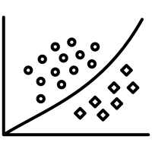
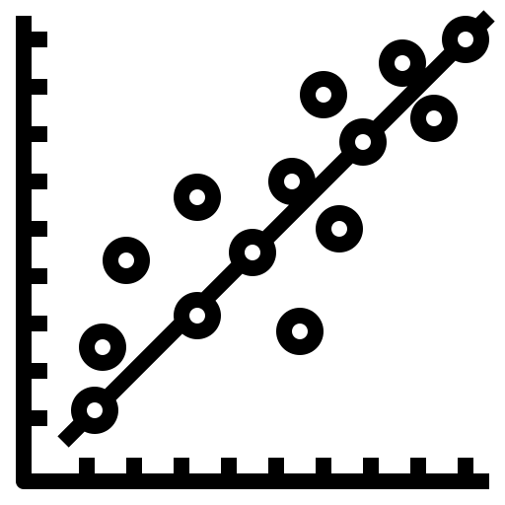

Why This Project?
We are all familiar with common applications of Deep Learning….
Classification
Regression
Natural Language Processing (NLP)

Slide 3

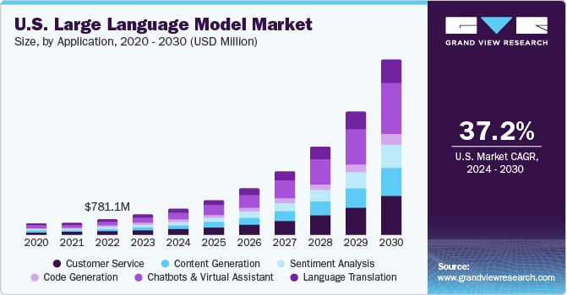
Why This Project?
And how they worked was a complete mystery to me
LLMs usage is only going to grow from now
Natural Language Processing (NLP)

Slide 4

A short introduction to LLMs
Predicting the next work from past inputs: It’s all math (probabilities)!
Source: 3Blue1Brown, YouTube

Slide 5
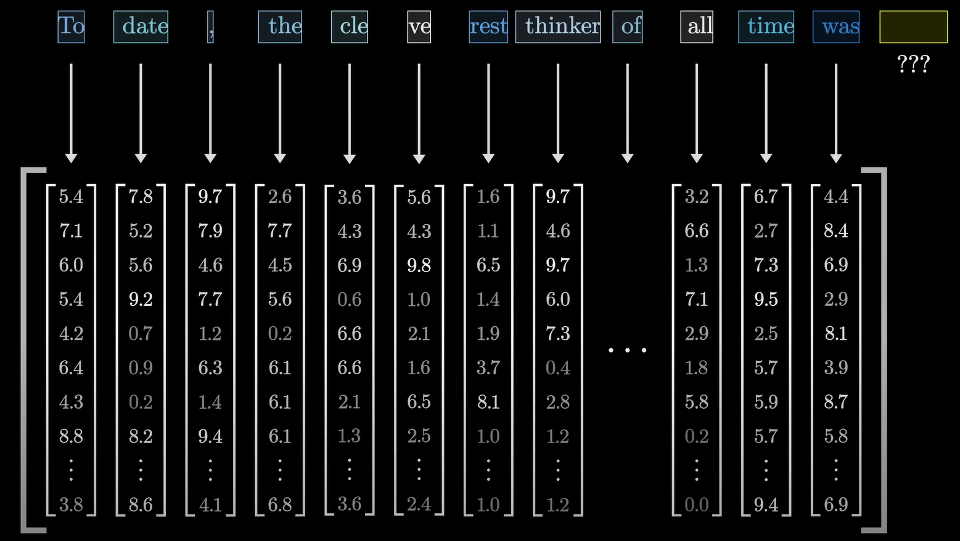
A short introduction to LLMs
Predicting the next work from past inputs: It’s all math (probabilities)!
But computers can’t understand words -> So we embed words using tokens
This looks an awful lot like regression, but…
Language is very complex, we need to understand semantic context, and so do computers
Source: 3Blue1Brown, YouTube

Slide 6
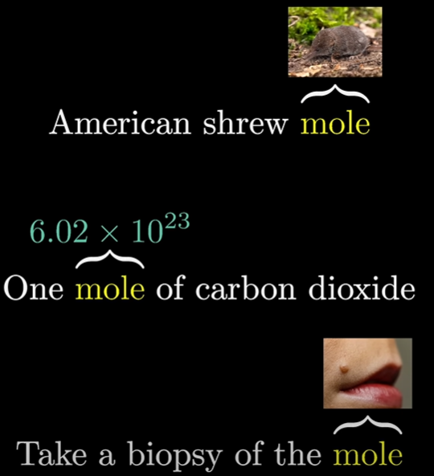
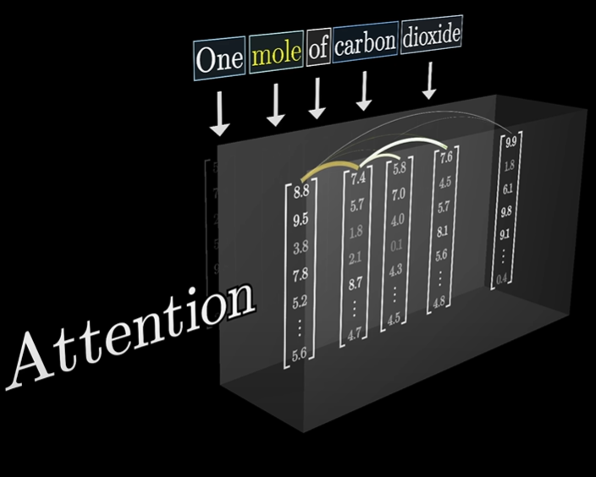
A short introduction to LLMs
TRANSFORMERS, or how to focus on what matters (attention)
A “magic” block:
They focus on all words at the same time
They know which words are most important, i.e., and adjective might serve to identify what a noun means
Source: 3Blue1Brown, YouTube

Slide 7
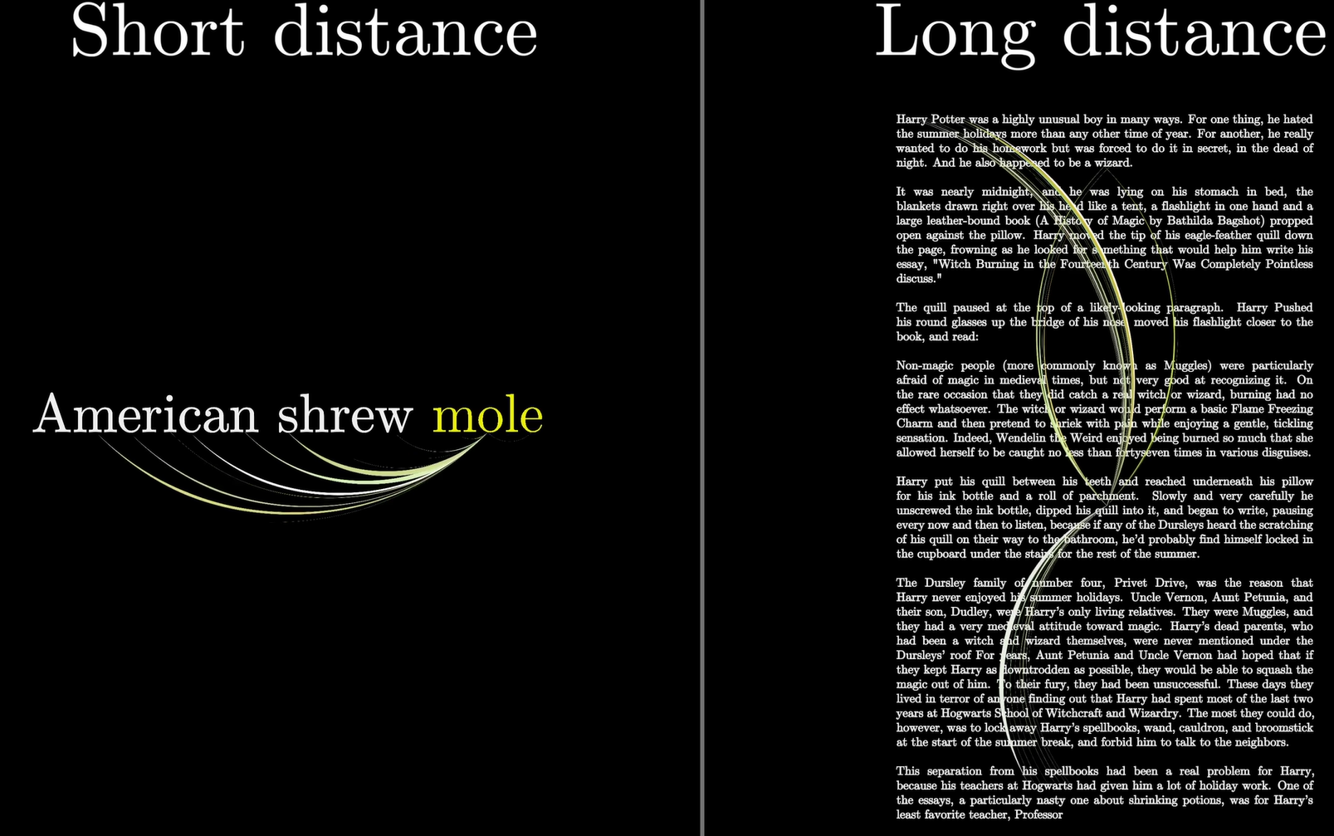
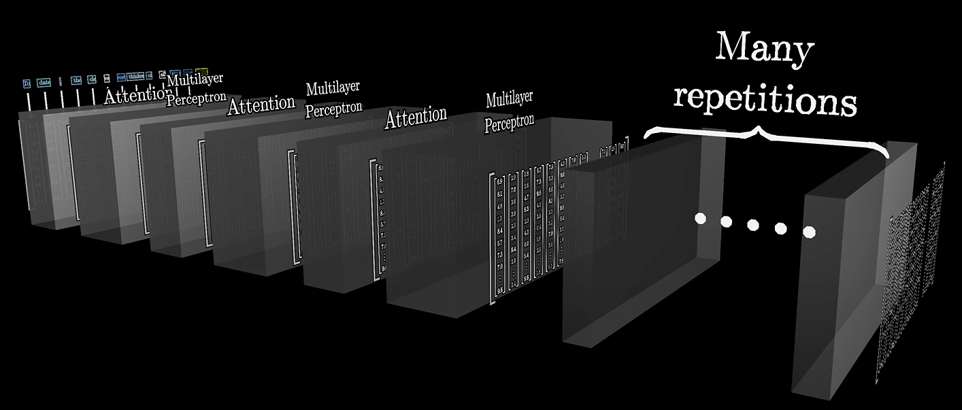
A short introduction to LLMs
TRANSFORMERS, or how to focus on what matters (attention)
If we need larger context spans, we need more parameters
Training these models is VERY expensive, and they need a TON of data
(thus the Large in Large-Language Models)
Source: 3Blue1Brown, YouTube

Slide 8
An achievable objective
Training these models is VERY expensive, and they need a TON of data
Current SOTA models are trained on the ENTIRETY of the internet (think ChatGPT, Llama, Gemini…)
I can use a pretrained model
(so it already knows about language) and I can fine tune it for a given task
So if I want to do something similar on my computer I obviously need to scale down
Question Answering: A classic task for NLP models, given a text, provide an answer
Context
Question
Answers
Beyoncé Giselle Knowles-Carter (/biːˈjɒnseɪ/ bee-YON-say) (born September 4, 1981) is an American singer, songwriter, record producer and actress. Born and raised in Houston, Texas, she performed in various singing and dancing competitions as a child, and rose to fame in the late 1990s as lead singer of R&B girl-group Destiny's Child. Managed by her father, Mathew Knowles, the group became one of the world's best-selling girl groups of all time. Their hiatus saw the release of Beyoncé's debut album, Dangerously in Love (2003), which established her as a solo artist worldwide, earned five Grammy Awards and featured the Billboard Hot 100 number-one singles "Crazy in Love" and "Baby Boy".
When did Beyonce start becoming popular?
{"text": [ "in the late 1990s" ], "answer_start": [ 269 ] }

Slide 9
Question Answering LLMs: nothing new out there
Two very popular datasets:
Rajpurkar, P., Zhang, J., Lopyrev, K., & Liang, P. (2016). SQuAD: 100,000+ Questions for Machine Comprehension of Text. ArXiv. https://arxiv.org/abs/1606.05250
SQuAD 1.1: contains 100,000+ question-answer pairs on 500+ Wikipedia articles.
Rajpurkar, P., Jia, R., & Liang, P. (2018). Know What You Don't Know: Unanswerable Questions for SQuAD. ArXiv. https://arxiv.org/abs/1806.03822
SQuAD2.0: 100,000 questions in SQuAD1.1 with over 50,000 unanswerable questions handmade to look like answerable ones
Tricking the machine: If you don’t know, you shouldn’t answer

Slide 10
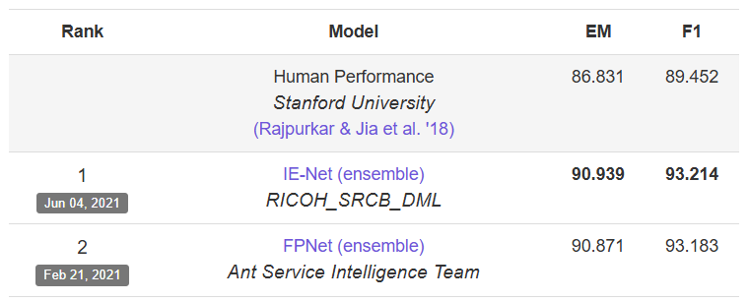
Question Answering LLMs: nothing new out there
Both datasets have been well explored (11,976 citations on GS, as of Nov. 2024)
Performance Metrics:
F1: harmonic mean of precision and recall *
Precision: number of correct words divided by the number of words in the predicted answer
Recall: number of correct words divided by the number of words in the ground truth answer
Exact Match: binary measure (0 or 1) checking if the model outputs match one of the ground truth answers exactly *
Computers have beaten human performance:
* For negative (empty, inexistent ground truth answer) examples, abstaining receives a score of 1, and any other response gets 0, for both exact match and F1
So how could I make it more interesting?
https://rajpurkar.github.io/SQuAD-explorer/

Slide 11
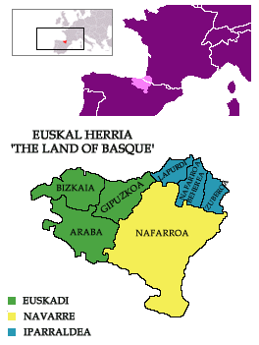

Question Answering NLP: Basque as a minority language
Most LLMs are trained mostly in English or other extensively used languages, which results in big biases towards these majority languages, but who thinks about the other language-speakers?
Some fun facts:
Around 806,000 people speak Basque, but in the Basque Country, only 30.6% of the population over 16 years old speaks Basque
It is unrelated to all known languages
Its origin is older than that of any other language in Europe

Slide 12
Question Answering NLP: Basque as a minority language
Increased efforts towards LLMs on minority languages:
Perez, N., Cuadros, M., & Bengoetxea, J. (2024). EuSQuAD: Automatically Translated and Aligned SQuAD2.0 for Basque. ArXiv. https://arxiv.org/abs/2404.12177
Beyoncé Giselle Knowles-Carter (/biːˈjɒnseɪ/ bee-YON-say) (born September 4, 1981) is an American singer, songwriter, record producer and actress. Born and raised in Houston, Texas, she performed in various singing and dancing competitions as a child, and rose to fame in the late 1990s as lead singer of R&B girl-group Destiny's Child. Managed by her father, Mathew Knowles, the group became one of the world's best-selling girl groups of all time. Their hiatus saw the release of Beyoncé's debut album, Dangerously in Love (2003), which established her as a solo artist worldwide, earned five Grammy Awards and featured the Billboard Hot 100 number-one singles "Crazy in Love" and "Baby Boy".
Beyonce Giselle Knowles-Carter (New York, Ameriketako Estatu Batuak, 1981eko irailaren 4a) estatubatuar abeslari, kantautore, ekoizle eta aktorea da. Houstonen (Texas) jaio eta hazi zen, eta txikitan hainbat kantu eta dantza lehiaketatan aritu zen, eta 1990eko hamarkadaren amaieran Destiny 's Child R & B neska taldeko abeslari nagusi gisa ospea lortu zuen. Bere aitak, Mathew Knowlesek, zuzentzen zuen taldea munduko neska talde salduenetako bat bihurtu zen. Haien hiatoek Beyonceren debut albuma argitaratu zuten, Dangerously in Love (2003), mundu osoan bakarlari gisa ezarri zuena, bost Grammy Sari irabazi zituen eta \"Crazy in Love\" eta \"Baby Boy\" singleak aurkeztu zituen.
When did Beyonce start becoming popular?
Noiz hasi zen Beyonce ezagun egiten?
{"text": [ "in the late 1990s" ],
"answer_start": [ 269 ] }
{"text": ["1990eko hamarkadaren amaieran"],
"answer_start": [253]}}
1:1 translation of the SQuAD2.0 Dataset (including negative answers)

Slide 13

Question Answering NLP: Working my way through the task
My first approach: try to replicate a previous implementation (using SQuAD2.0, and BERT)
The BERT model
Self-supervised pre-training on English corpus:
Masked Language Modelling (try to predict missing word)
Next Sentence Prediction (learn if the next sentence is a continuation of a given sentence)
Has bidirectional understanding of sentences
Inner Representation of Language using 110M parameters
https://huggingface.co/google-bert/bert-base-uncased

Slide 14
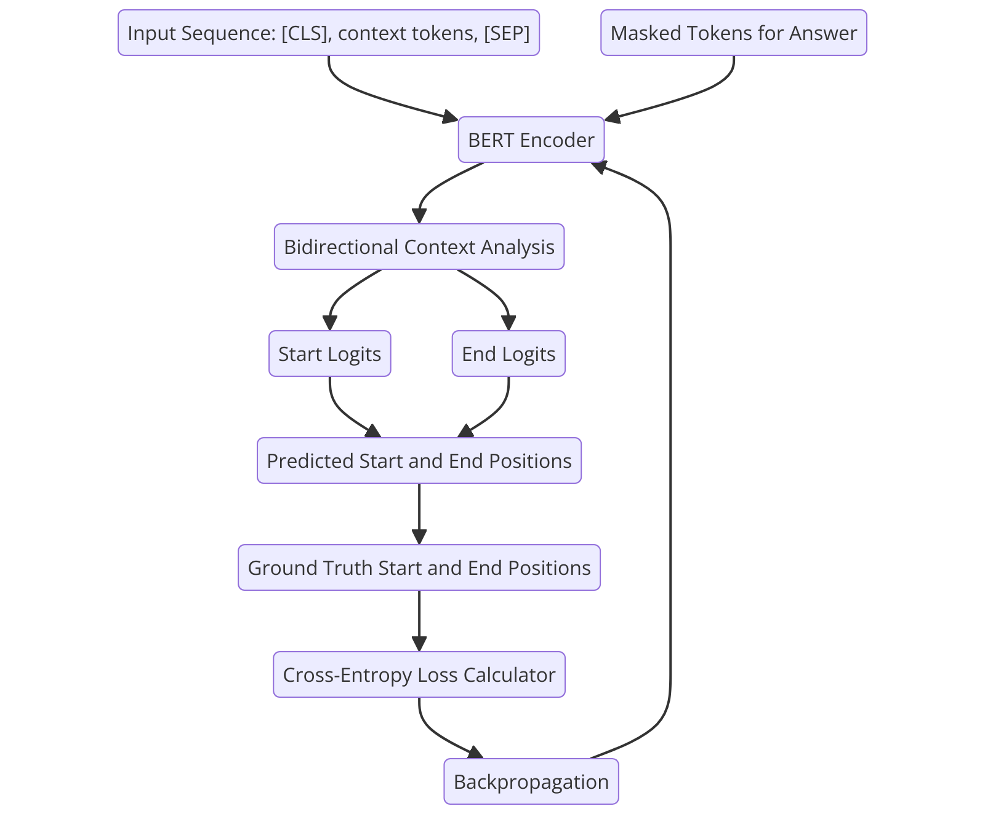
Question Answering NLP: Working my way through the task
The BERT model
How do we train it to predict an answer from a given text?
Very clever solution:
Feed it the tokenized context, question and answer
For each token in the context, predict the probabilities of it being either the start or the end of the answer, this process is called predicting the logits
Compare predicted logits vs. ground truth logits: cross-entropy-loss
Backpropagate
REPEAT
A
LOT
Seriously, a lot
~ 24 hours for each attempt at training

Slide 15

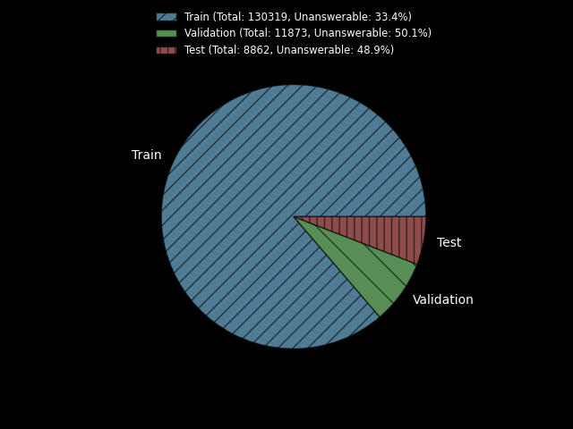
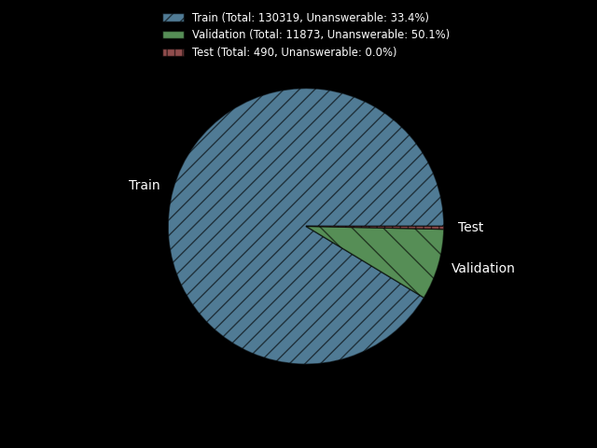
Question Answering NLP: a problem with the datasets
And after struggling with setting up the models and the datasets for training, I started training…
But I made the biggest mistake someone can make in ML:
What about the test set????
Original datasets:
SQuAD2.0 Dataset
EuSQuAD Dataset
Manually crafted
No negative answers
Most importantly, asked the authors to share the test set, and they did not for copyright issues
Private
~2 weeks for evaluation on test set

Slide 16
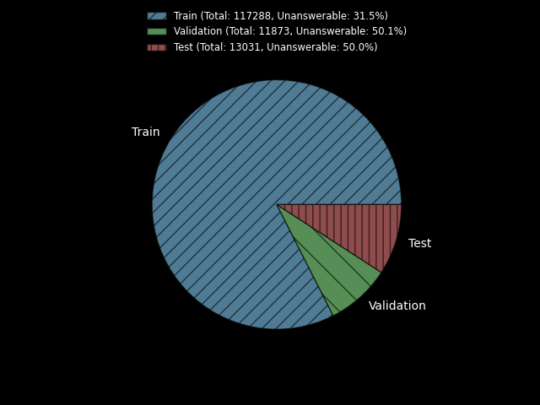

Question Answering NLP: a problem with the datasets
So I had to restart from the beginning…
Leave-out 10% of the training data for testing
Pseudorandom approach:
50/50 answerable/unanswerable questions
“Modified” datasets:
SQuAD2.0 Dataset
EuSQuAD Dataset

Slide 17


Question Answering NLP: different approaches
From more general (and easier), to more specific
Fine tune
The BERT model
SQuAD2.0 Dataset
The mBERT model
Trained on the top 104 languages on Wikipedia, including Basque
Fine tune
EuSQuAD Dataset
Fine tune
The ixamBERT model
Trained on English, Spanish, and Basque
EuSQuAD Dataset
Fine tune
The BERTeus model
Fully trained on Basque
EuSQuAD Dataset

Slide 18
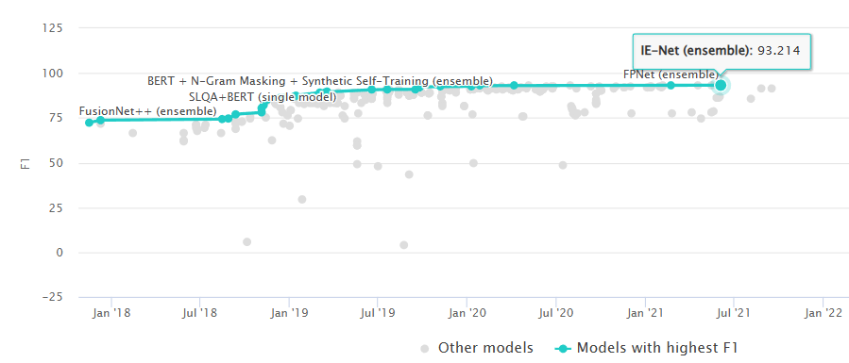
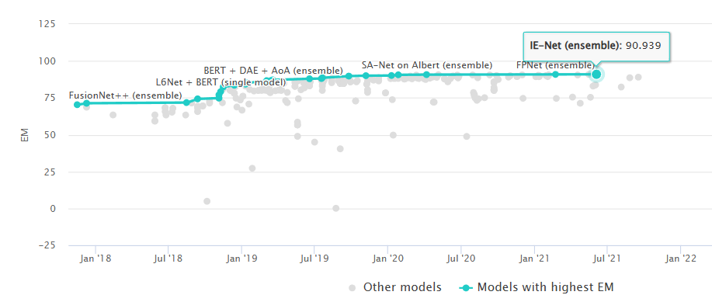
Question Answering NLP: An so retraining/refinetuning began
Keeping it simple: using the same hyperparameters as those in the EuSQuAD paper, can we replicate the results?
hyperparameters = {
'learning_rate': 3e-5,
'num_train_epochs’: 6,
'batch_size’: 8,
'gradient_accumulation_steps': 16,
'weight_decay': 0.02,
'warmup_ratio': 0.2
}
The BERT model
Fine tune
SQuAD2.0 Dataset
Test results:
F1: (50%)
F1(answerable): (0%)
F1 (unanswerable): (100%)
Exact Match: (50%)
EM (answerable): (0%)
EM (unanswerable): (100%)
(take into account that our test set is different from the one in this leaderboard, so this is just as an orientation)
* In orange: performance of a model that always abstains from answering
https://paperswithcode.com/sota/question-answering-on-squad20

Slide 19
Question Answering NLP: An so retraining/refinetuning began
Keeping it simple: using the same hyperparameters as those in the EuSQuAD paper, can we replicate the results?
hyperparameters = {
'learning_rate': 3e-5,
'num_train_epochs’: 6,
'batch_size’: 8,
'gradient_accumulation_steps': 16,
'weight_decay': 0.02,
'warmup_ratio': 0.2
}
The mBERT model
Fine tune
EuSQuAD Dataset
Test results:
F1: (50%) (55.8%)
F1(answerable): (0%)
F1 (unanswerable): (100%)
Exact Match: (50%) (44.6%)
EM (answerable): (0%)
EM (unanswerable): (100%)
* In orange: performance of a model that always abstains from answering
(take into account that our test set is different from the they used, so this is just as an orientation)
Performance achieved in the original paper

Slide 20
Question Answering NLP: An so retraining/refinetuning began
Keeping it simple: using the same hyperparameters as those in the EuSQuAD paper, can we replicate the results?
hyperparameters = {
'learning_rate': 3e-5,
'num_train_epochs’: 6,
'batch_size’: 8,
'gradient_accumulation_steps': 16,
'weight_decay': 0.02,
'warmup_ratio': 0.2
}
The ixamBERT model
Fine tune
EuSQuAD Dataset
Test results:
F1: (50%) (65.1%)
F1(answerable): (0%)
F1 (unanswerable): (100%)
Exact Match: (50%) (51.3%)
EM (answerable): (0%)
EM (unanswerable): (100%)
* In orange: performance of a model that always abstains from answering
(take into account that our test set is different from the they used, so this is just as an orientation)
Performance achieved in the original paper

Slide 21
Question Answering NLP: An so retraining/refinetuning began
Keeping it simple: using the same hyperparameters as those in the EuSQuAD paper, can we replicate the results?
hyperparameters = {
'learning_rate': 3e-5,
'num_train_epochs’: 6,
'batch_size’: 8,
'gradient_accumulation_steps': 16,
'weight_decay': 0.02,
'warmup_ratio': 0.2
}
The BERTeus model
Fine tune
EuSQuAD Dataset
Test results:
F1: (50%) (65.7%)
F1(answerable): (0%)
F1 (unanswerable): (100%)
Exact Match: (50%) (52.8%)
EM (answerable): (0%)
EM (unanswerable): (100%)
* In orange: performance of a model that always abstains from answering
(take into account that our test set is different from the they used, so this is just as an orientation)
* In blue Performance achieved in the original paper
Maybe its better to do a boxplot of the basque models more readability and easier to understand

Slide 22
Question Answering NLP: Visualizing the magic
Keeping it simple: using the same hyperparameters as those in the EuSQuAD paper, can we replicate the results?
hyperparameters = {
'learning_rate': 3e-5,
'num_train_epochs’: 6,
'batch_size’: 8,
'gradient_accumulation_steps': 16,
'weight_decay': 0.02,
'warmup_ratio': 0.2
}
The BERTeus model
Fine tune
EuSQuAD Dataset
Test results:
F1: (50%) (65.7%)
F1(answerable): (0%)
F1 (unanswerable): (100%)
Exact Match: (50%) (52.8%)
EM (answerable): (0%)
EM (unanswerable): (100%)
* In orange: performance of a model that always abstains from answering
(take into account that our test set is different from the they used, so this is just as an orientation)
* In blue Performance achieved in the original paper
Maybe its better to do a boxplot of the basque models more readability and easier to understand

